Slide 1
Sampling-based Motion Planning for Legged Robots
Yanran Ding, Mengchao Zhang, Haoran Tang
Y
M
H

Slide 2

Motivation

Slide 3


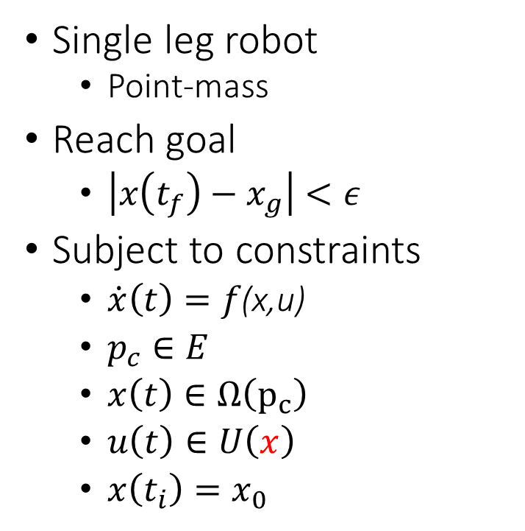

Problem Statement
parabola
Single leg robot
Point-mass
Reach goal
$\left|x\left(t_{f}\right)−x_{g}\right|<ε$
Subject to constraints
$\dot{x}\left(t\right)=f\text{(}\text{x}\text{,}\text{u}\text{)}$
$p_{c}∈E$
$x\left(t\right)∈Ω\left(p_{c}\right)$
$u\left(t\right)∈U\left(x\right)$
$x\left(t_{i}\right)=x_{0}$
Friction cone
$$p$$
$$θ$$
Terrain
$$f$$
Goal region
Static foothold
CoM in Stance
CoM in Flight

Slide 4
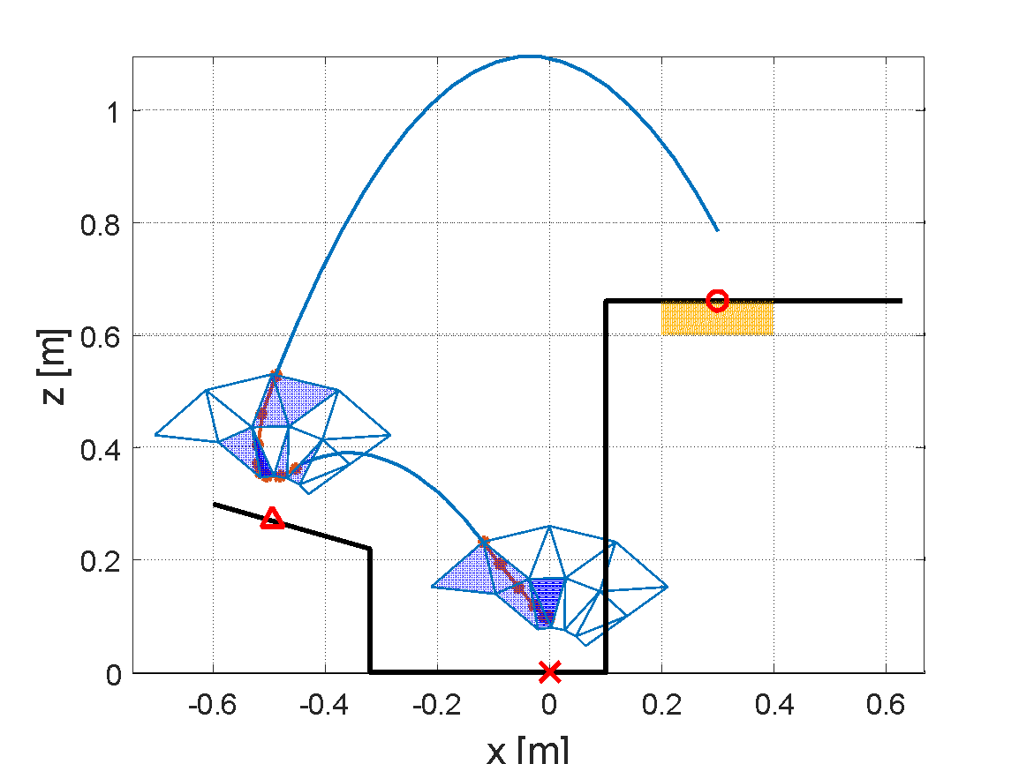
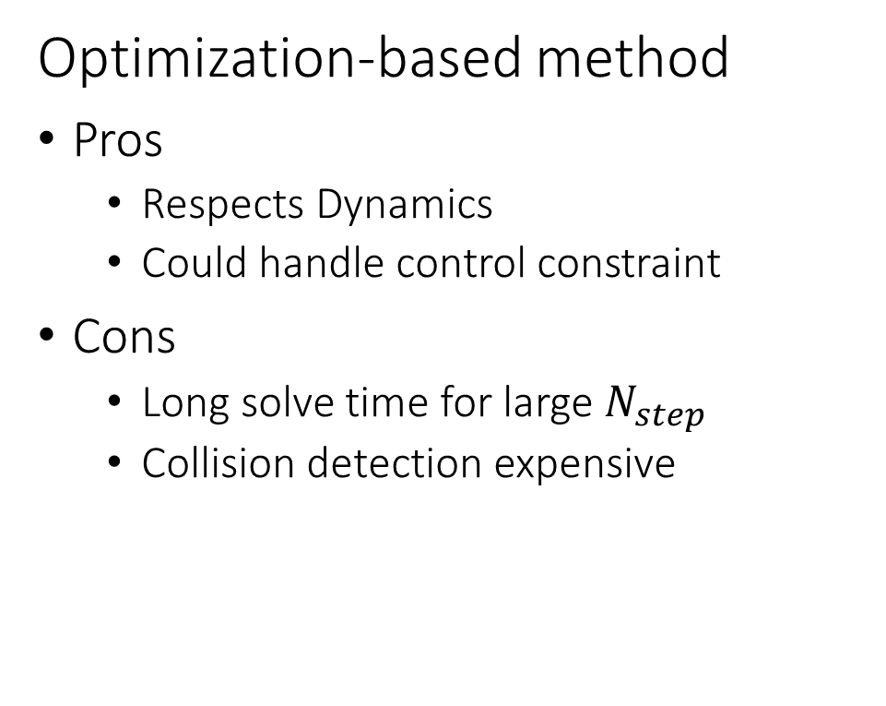
Existing Method
Optimization-based method
Pros
Respects Dynamics
Could handle control constraint
Cons
Long solve time for large $N_{step}$
Collision detection expensive
Trajectory Optimization (TO)
Mixed-Integer Convex Program (MICP)

Slide 5


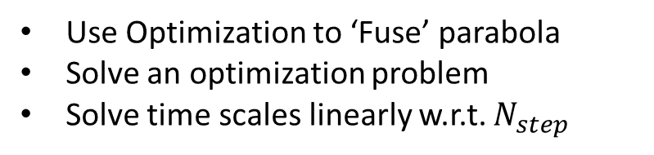
Proposed Framework
Terrain
1. Sampling Step
Path as a sequence of parabola
Effective for complex terrain
Inexpensive to check collision
Kinematically-Feasible path
Terrain
2. Optimization Step
$$v_{out}$$
Use Optimization to ‘Fuse’ parabola
Solve an optimization problem
Solve time scales linearly w.r.t. $N_{step}$
Dynamically-Feasible path
$$v_{in}$$
3. Feedback Controller

Slide 6
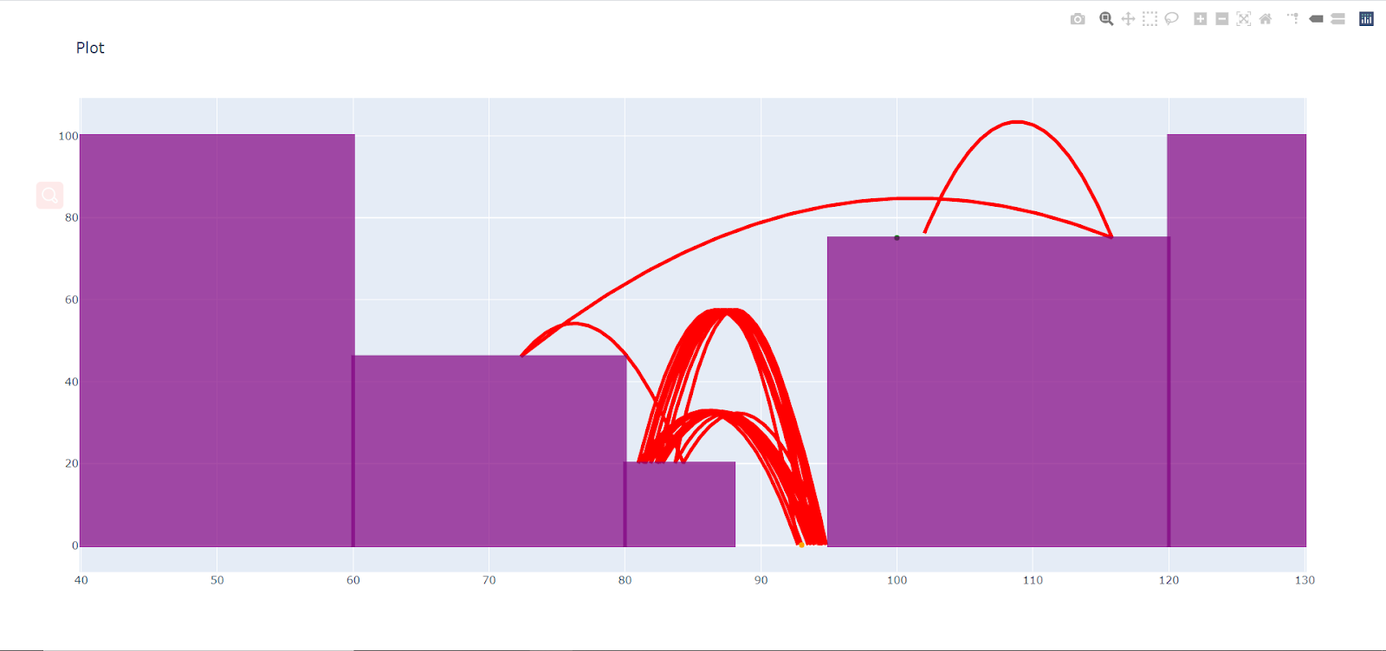
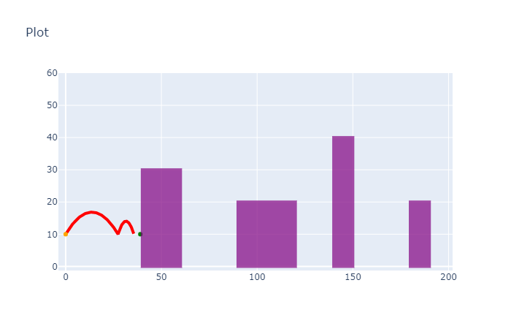
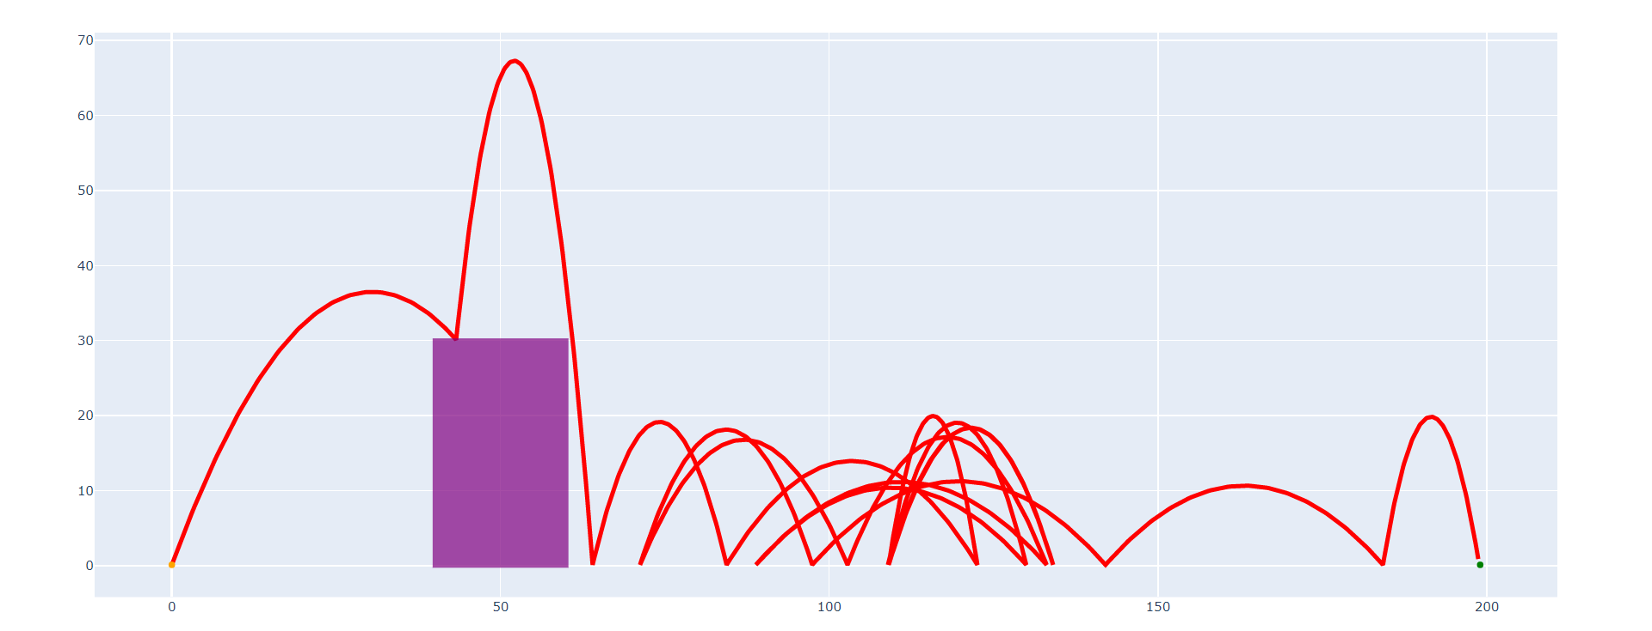

Sampling Step
Terrain
Sample Space: Task space
Data Structure: Path
1. Sampling Step
Sample Strategy: Reachability guided
Sample in reachable region of current point $P_{k}$
Sample point not too close to $P_{k}$ nor $P_{k−1}$
Not too close to obstacle
If no obstacle between $P_{k}$ and goal, always jump towards the goal
…
Kinematically-Feasible path
2. Optimization Step
Heuristics
Dynamically-Feasible path
3. Feedback Controller
Find parabola
Post-processing

Slide 7
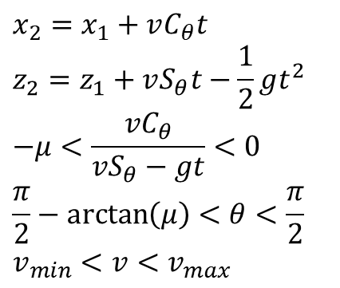






Sampling Step
Terrain
Sample Space: State space
Data Structure: Path
1. Sampling Step
Sample Strategy: Reachability guided
Heuristics
Kinematically-Feasible path
$$minimize_{v,θ,t} t$$
$$v$$
$$θ$$
$$subject to$$
$$(x_{2},z_{2})$$
2. Optimization Step
$$(x_{1},z_{1})$$
$$x_{2}=x_{1}+vC_{θ}t$$
$$z_{2}=z_{1}+vS_{θ}t−\frac{1}{2}gt^{2}$$
$$−μ<\frac{vC_{θ}}{vS_{θ}−gt}<0$$
$$\frac{π}{2}−\arctan\left(μ\right)<θ<\frac{π}{2}$$
$$v_{min}<v<v_{max}$$
Formed and solved as a small-scale nonlinear programming (NLP)
Find parabola
Dynamically-Feasible path
3. Feedback Controller
Post-processing

Slide 8
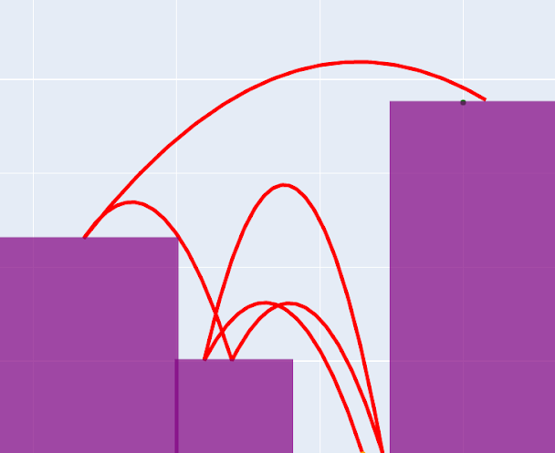
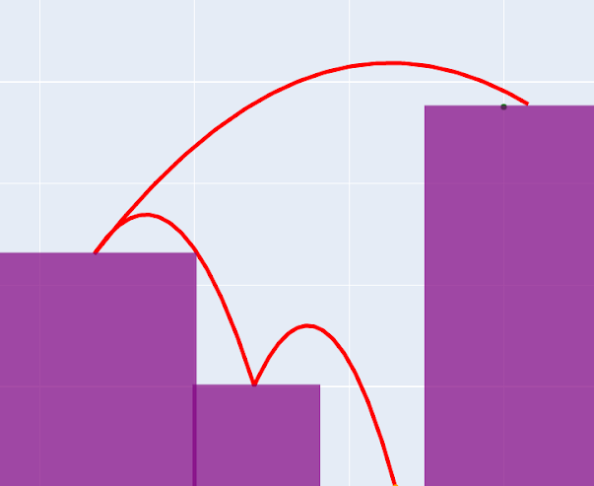
Sampling Step
Terrain
Sample Space: State space
Data Structure: Path
1. Sampling Step
Sample Strategy: Reachability guided
Heuristics
Kinematically-Feasible path
Find parabola
Before
2. Optimization Step
Post-processing
(discard small steps)
Dynamically-Feasible path
3. Feedback Controller
After

Slide 9
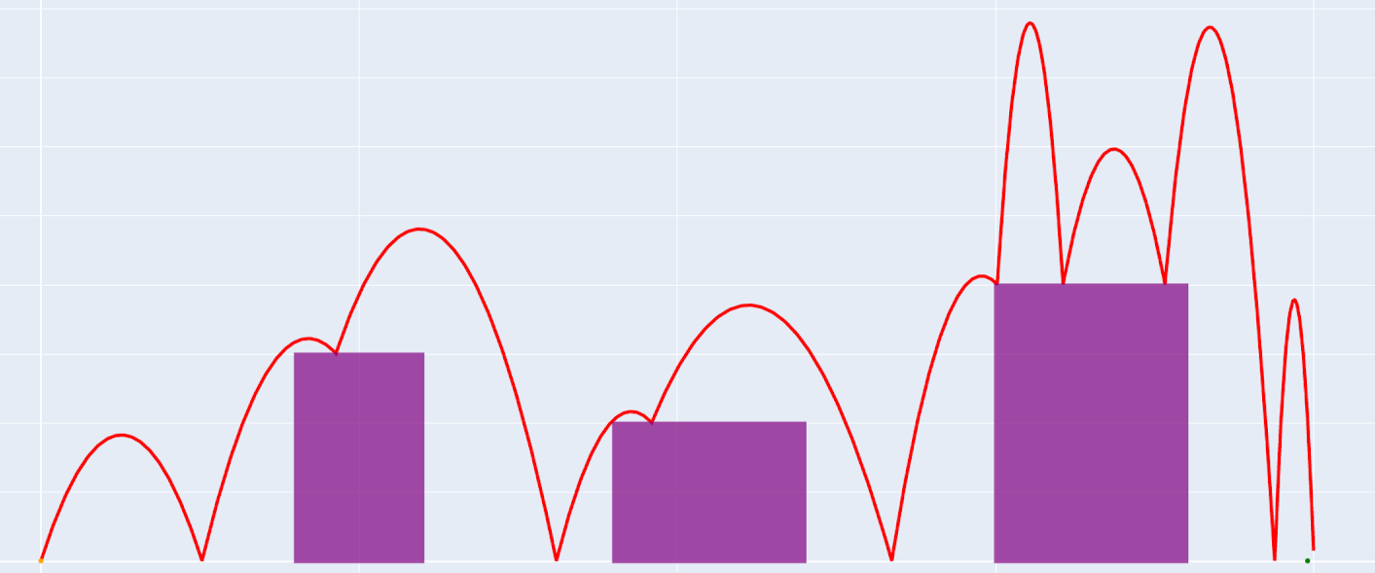
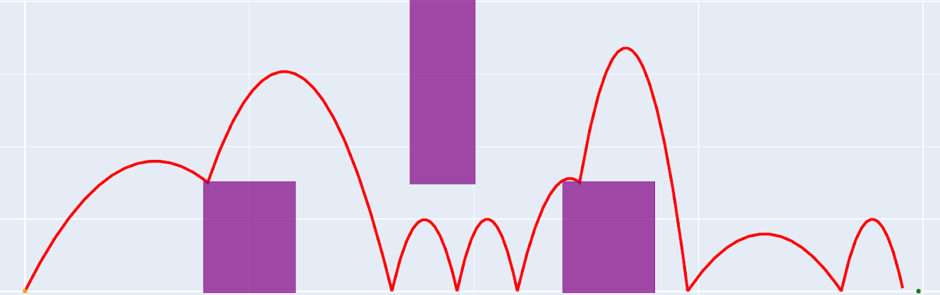
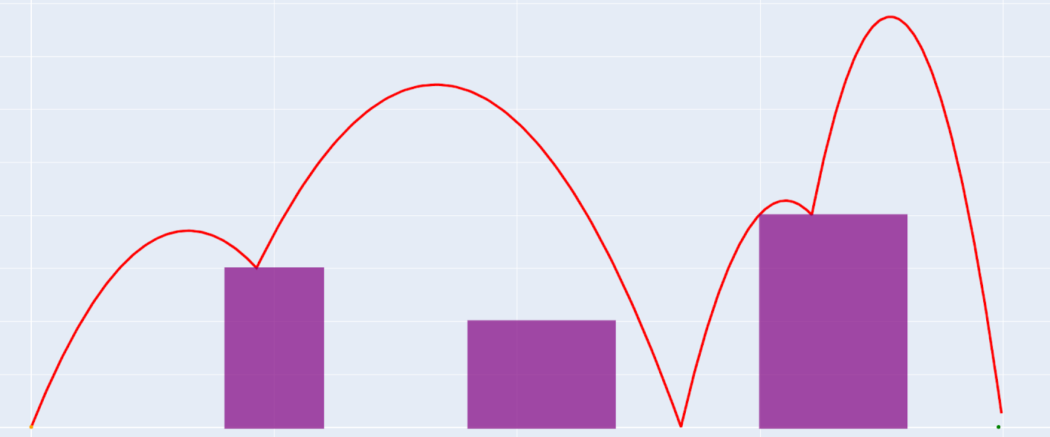
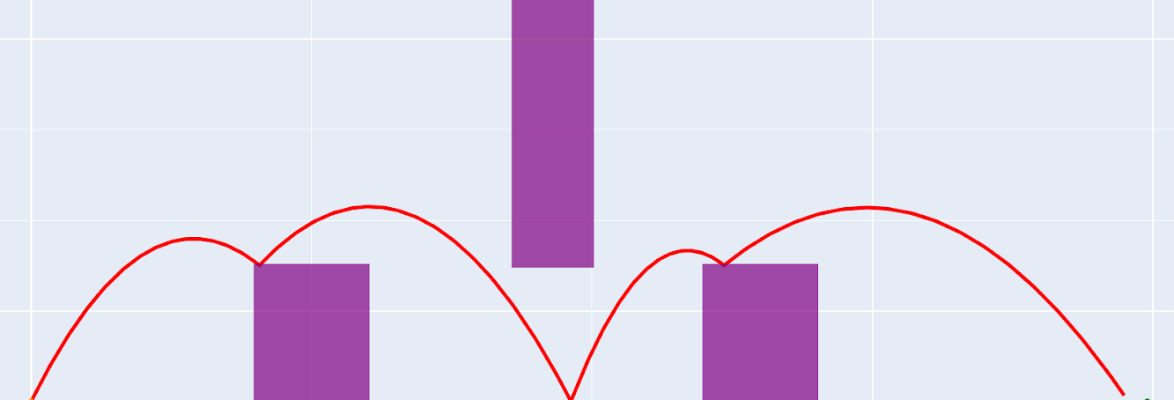
Post Processing
before
after

Slide 10
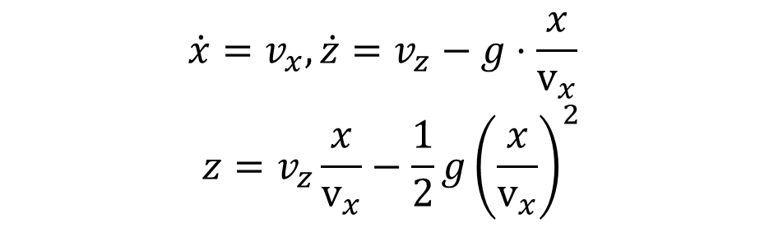


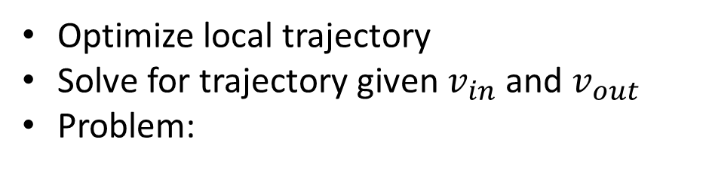



Optimization Step
Optimize local trajectory
Solve for trajectory given $v_{in}$ and $v_{out}$
Problem:
find control trajectory that drives the initial condition on inward parabola to the final condition on the outward parabola
$$v_{out}$$
$$(x_{i},z_{i})$$
$$(x_{f},z_{f})$$
$$0$$
$$\dot{x}=v_{x}, \dot{z}=v_{z}−g⋅\frac{x}{v_{x}}$$
$$z=v_{z}\frac{x}{v_{x}}−\frac{1}{2}g{\left(\frac{x}{v_{x}}\right)}^{2}$$
velocity
$$v_{in}$$
Symmetric for inward/outward parabola
position
Position constraint is nonconvex → mixed-integer convex relaxation

Slide 11
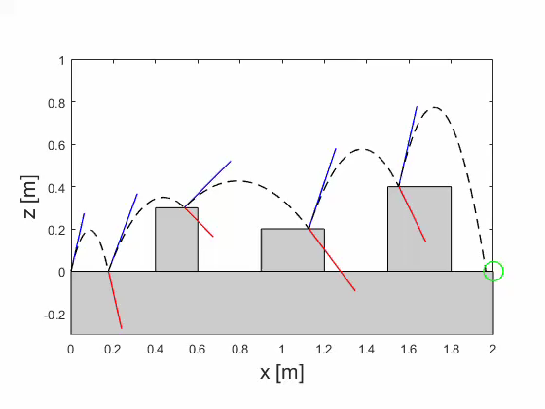
Results
Mario
Solve time
Sampling step [s]: 0.1
Optimization step [s]: 24
1.2, 1.8, 3.5, 12.2, 6.5

Slide 12
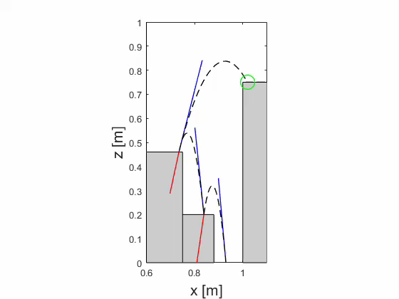
Results
Jackie Chan
Solve time
Sampling step [s]: 0.3
Optimization step [s]: 3.6
1.6, 1.3, 0.7

Slide 13
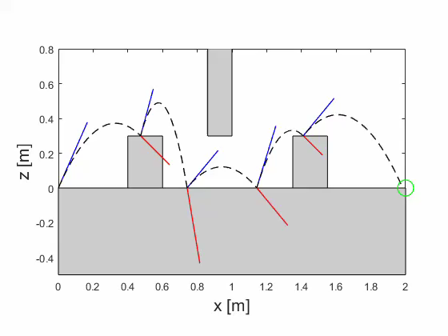
Results
Solve time
Sampling step [s]: 0.3
Optimization step [s]: 13.8
1.0, 0.5, 10.0, 1.1, 1.2
Indiana Jones

Slide 14
Conclusion and Future Work
Conclusion
We present a Sampling-Optimization Hierarchical Motion Planning for Legged Robots
This method exploits the advantages of both methods to produce solution to complex problem with low computational cost
Future Work
Allow for more complex terrain/ moving obstacles
Integrate with Feedback controller to handle uncertainty

Slide 15
Contribution
Yanran Ding
In charge of optimization step
Code the optimization in MATLAB
Brainstorm ideas
Y
Mengchao Zhang
In charge of Sampling step
Code the sampling step in Python
Generate the test scenarios
M
Haoran Tang
Post-processing of the sampled parabola
H

Slide 16
Q & A

Slide 17
Backup Slides

Slide 18
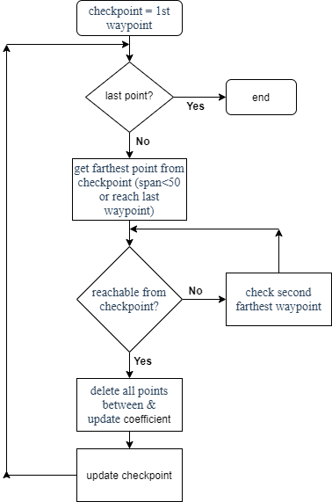
Post Processing
Forward optimizing:
pro: straightforward logic
con: harder to update (need to reconstruct list and calculate new iteration index)----solved by linked list
Backward optimizing: pro: no linked list, faster and more efficient (append waypoint at the tail)
con: harder to design and develop

Slide 19
Sampling Step
Terrain
Sample Space: State space
Data Structure: Path
1. Sampling Step
Sample Strategy: Reachability guided
Heuristics
Kinematically-Feasible path
Find parabola
2. Optimization Step
Methods | Pro | Con
Forward optimizing | Logic straightforward | More difficult to update
Backward optimizing | More efficient | More difficult to design
Post-processing
(discard small steps)
Dynamically-Feasible path
3. Feedback Controller

